Slide 1
Motion Illusions as Optimal Percepts CSCI 5822 Probabilistic Models of Human and Machine Intelligence
Spring 2018
Professor Michael Mozer

Slide 2
What’s Special About Perception?
Visual perception important for survival ➔Likely optimized by evolution
at least more so than other cognitive abilities
Human visual perception outperforms all modern computer vision systems.
Understanding human vision should be helpful for building AI systems

Slide 3
Ambiguity of Perception
One-to-many mapping of retinal image to objects in the world
Same issue with 2D retina and 3D images
Notes:
perception is an inference problem. this class is about inference

Slide 4
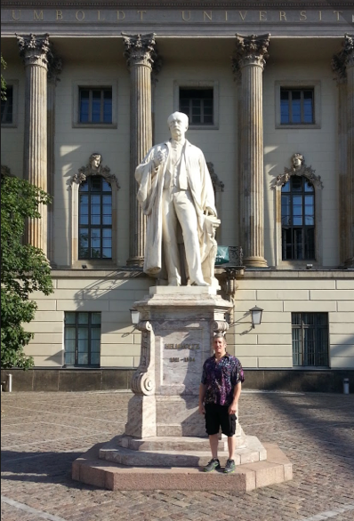
Hermann von Helmholtz (1821-1894)
German physician/physicist who made significant contributions to theories of vision
Perception as unconscious inference
Recover the most likely objects in the world based on the ambiguous visual evidence
Percept is a hypothesis about what the brain thinks is out there in the world.
Notes:
Humboldt u Berlin

Slide 5
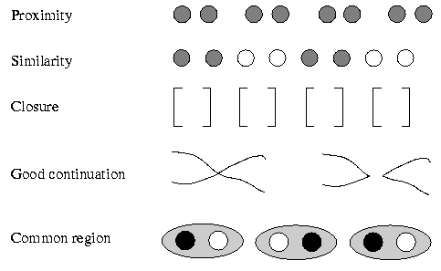
Additional Knowledge Is Required To Perceive
Innate knowledge
E.g., any point in the image has only one interpretation
E.g., surfaces of an object tend to be a homogeneous color
Gestalt grouping principles
Specific experience
E.g., SQT is an unlikely letter combination in English
E.g., bananas are yellow or green, not purple

Slide 6
Illusions
Most of the time, knowledge helps constrain perception to produce the correct interpretation of perceptual data.
Illusions are the rare cases where knowledge misleads
E.g., hollow face illusion
http://www.michaelbach.de/ot/fcs_hollow-face/
Constraints: light source, shading cues, knowledge of faces

Slide 7
The Aperture Problem
Some slides adapted from Alex Pouget, Rochester
Notes:
Aperture introduces uncertainty

Slide 8
The Aperture Problem

Slide 9
The Aperture Problem
Vertical velocity (deg/s)
vertical velocity
horizontal velocity
Horizontal velocity (deg/s)
Notes:
You cannot tell how much motion is taking place along the axis aligned with the yellow bar -> motion ambiguity

Slide 10
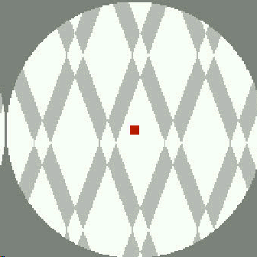
The Aperture Problem: Plaid
Notes:
PLAID STIMULUS – criss-crossing lines with the point of intersection (shown as a white diamond initially) going from light to dark
phenomenon: white diamond -> move up, grey diamond (diamond vanishes) -> move up, darker diamond -> different directions, very dark diamond -> move up
the separation happens when the diamond is colored such that the pattern can be interpreted as superimposed translucent bars

Slide 11
The Aperture Problem: Plaid
Vertical velocity (deg/s)
Horizontal velocity (deg/s)
Notes:
if you interpret the image as a single object made up of lines in two orientations -> only possible interpretation is up (intersection)
if you interpret image as two objects, then same ambiguity we had with the single line in an aperture

Slide 12
The Aperture Problem: Rhombus
Vertical velocity (deg/s)
Horizontal velocity (deg/s)
Notes:
here’s another formulation of the plaid stimulus for the case where the image is interpreted as a single object
WHY HAVE I BLOCKED OFF CORNERS?

Slide 13
The Aperture Problem
Vertical velocity (deg/s)
Horizontal velocity (deg/s)
Actual motion in blue
Notes:
no ambiguity because information from two edges is integrated

Slide 14
Standard Models of Motion Perception
Feature tracking
focus on distinguishing features
IOC
intercept of constraints
VA
vector average
Notes:
display feature: e.g., maximum luminance

Slide 15
Standard Models of Motion Perception
IOC
VA
Vertical velocity (deg/s)
Horizontal velocity (deg/s)
Notes:
vector average -> average of 2 smallest possible motions

Slide 16
Standard Models of Motion Perception
IOC
VA
Vertical velocity (deg/s)
Horizontal velocity (deg/s)

Slide 17
Standard Models of Motion Perception
Problem
Perceived motion is close to either IOC or VA depending on stimulus duration, retinal eccentricity, contrast, speed, and other factors.
Maybe perception is an ad hoc combination of models, but that’s neither elegant nor parsimonious.

Slide 18
Standard Models of Motion Perception
Example: Rhombus With Corners Occluded
Actual motion
Actual motion
Percept: IOC
Percept: VA
VA
IOC
VA
IOC
Vertical velocity (deg/s)
Vertical velocity (deg/s)
Horizontal velocity (deg/s)
Horizontal velocity (deg/s)

Slide 19
Rhombus Thickness Influences Perception
rhombus demo

Slide 20
Bayesian Model of Motion Perception
Perceived motion correspond to the Maximum a Posteriori (MAP) estimate
v: velocity vector
I: snapshot of image at 2 consecutive moments in time
Notes:
MAP vs. ML

Slide 21
* Digression *
Maximum a posteriori
Maximum likelihood
Notes:
QUESTION: which of these is Bayesian?

Slide 22
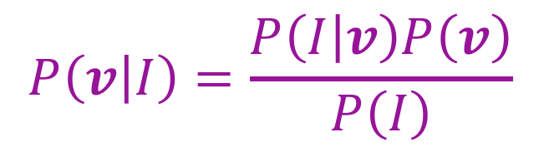
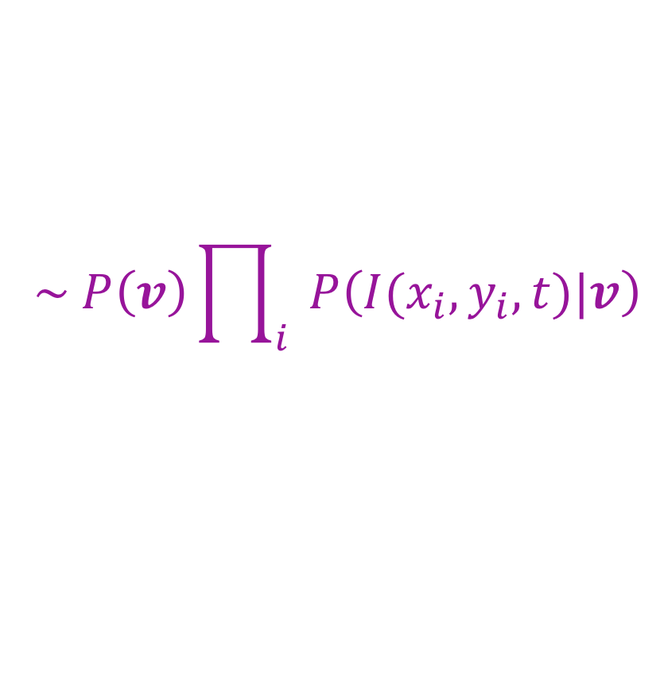
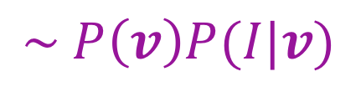
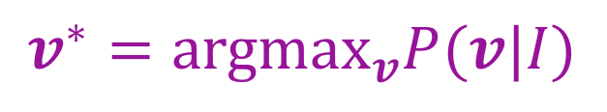
Bayesian Model of Motion Perception
Perceived motion corresponds to the Maximum a Posteriori (MAP) estimate
$$v^{∗}={argmax}_{v}P(v|I)$$
$$P\left(v | I\right)=\frac{P\left(I | v\right)P\left(v\right)}{P\left(I\right)}$$
$$\sim P\left(v\right)P(I|v)$$
Shorthand for how image is
changing in a neighborhood
over time
$$\sim P\left(v\right)\prod_{i}{P\left(I(x_{i},y_{i}, t)|v\right)}$$
Conditional independence
of observations
Notes:
MAP vs. ML
P(I(x_i, y_i) | v) is shorthand for a

Slide 23
Prior
Weiss and Adelson: Human observers favor slow motions
50
Vertical Velocity
0
-50
-50
0
50
Horizontal Velocity
Notes:
Rotating wheel
Switching dot patterns

Slide 24
Likelihood
Weiss and Adelson
50
Vertical Velocity
0
-50
-50
0
50
Horizontal Velocity
Notes:
Noise in perception of motion perpendicular to edge, uncertainty in motion along axis of edge

Slide 25
Likelihood
First-order
Taylor series
expansion
Notes:
1: likelihood model for the noise
2: taylor series expansion for prior image intensity – Ix, Iy, It are derivatives with respect to x, y, and t
3: Ix, Iy, It = partial derivatives with respect to x,y,t
INTUITION: if vx is large then image should be changing in x direction; vy -> y

Slide 26
Likelihood
Notes:
Multiple image locations

Slide 27
Posterior

Slide 28
Bayesian Model of Motion Perception
Perceived motion corresponds to the MAP estimate
Gaussian prior, Gaussian likelihood
→ Gaussian posterior
→ MAP is mean of Gaussian
Only one free parameter
Notes:
Solution on second line…. DERIVATION ON NEXT SLIDE!

Slide 29
Solving for MAP Velocity

Slide 30
Motion Through An Aperture
Likelihood
50
Vertical Velocity
0
-50
-50
0
50
ML
Horizontal Velocity
50
50
Vertical Velocity
Vertical Velocity
MAP
0
0
-50
-50
Prior
-50
0
50
-50
0
50
Posterior
Horizontal Velocity
Horizontal Velocity
Notes:
Based on likelihood only, motion is up and any horizontal velocity
ML solution no good, need PRIOR
Red is perceived velocity vector

Slide 31
Driving In The Fog
Drivers in the fog tend to speed up
underestimation of velocity
Explanation
Fog results in low contrast visual information
In low contrast situations, poor quality visual information about speed
Priors biased toward slow speeds
Prior dominates

Slide 32
Influence Of Contrast On Perceived Velocity
Likelihood
50
Vertical Velocity
0
High
Contrast
-50
-50
0
50
ML
Horizontal Velocity
50
50
Vertical Velocity
Vertical Velocity
MAP
0
0
-50
-50
Prior
-50
0
50
-50
0
50
Posterior
Horizontal Velocity
Horizontal Velocity
Notes:
same as situation I showed before

Slide 33
Influence Of Contrast On Perceived Velocity
Likelihood
50
Vertical Velocity
0
Low
Contrast
-50
-50
0
50
ML
Horizontal Velocity
50
50
MAP
Vertical Velocity
Vertical Velocity
0
0
-50
-50
Prior
-50
0
50
-50
0
50
Posterior
Horizontal Velocity
Horizontal Velocity

Slide 34
Influence Of Contrast On Perceived Direction
high vs. low contrast rhombus
Notes:
Should see horizontal motion with high contrast
Slightly downward motion with low contrast

Slide 35
Influence Of Contrast On Perceived Direction
Low contrast -> greater uncertainty in motion direction
Blurred information from two edges can combine if edges have similar angles
Notes:
The example from the paper with an acute angle

Slide 36
Influence Of Contrast On Perceived Direction
Likelihood
50
50
Vertical Velocity
Vertical Velocity
0
0
High
Contrast
-50
-50
-50
0
50
-50
0
50
IOC
Horizontal Velocity
Horizontal Velocity
50
50
MAP
Vertical Velocity
Vertical Velocity
0
0
-50
-50
Prior
-50
0
50
-50
0
50
Posterior
Horizontal Velocity
Horizontal Velocity

Slide 37
Influence Of Contrast On Perceived Direction
Likelihood
50
50
Vertical Velocity
Vertical Velocity
0
0
Low
Contrast
-50
-50
-50
0
50
-50
0
50
IOC
Horizontal Velocity
Horizontal Velocity
50
50
MAP
Vertical Velocity
Vertical Velocity
0
0
-50
-50
Prior
-50
0
50
-50
0
50
Posterior
Horizontal Velocity
Horizontal Velocity
Notes:
affects speed as we said previously but also direction

Slide 38
Influence Of Edge Angles On Perceived Direction Of Motion (Original Demo)
Example: Rhombus
Actual motion
Percept: IOC
Percept: VA
VA
IOC
VA
IOC
Vertical velocity (deg/s)
Vertical velocity (deg/s)
Horizontal velocity (deg/s)
Horizontal velocity (deg/s)
Notes:
Coming back to original demo…

Slide 39
Greater alignment of edges -> less benefit of combining information from the two edges

Slide 40
Barberpole Illusion (Weiss thesis)
Actual motion
Perceived motion
Notes:
PHENOMENON
Grating viewed through circular aperture: move in diagonal (slowest motion consistent with data)
Why circle: no edges – edges provide unambiguous evidence of direction because you can establish the correspondence between points
grating viewed through rectangular aperture: moving in direction of the long axis
edge provides evidence of motion along edge
if one edge is longer than the other, then it provides more evidence

Slide 41
Motion Illusions As Optimal Percepts
Mistakes of perception are the result of a rational system designed to operate in the presence of uncertainty.
A proper rational model incorporates actual statistics of the environment
Here, authors assume without direct evidence: (1) preference for slow speeds (2) noisy local image measurements (3) velocity estimate is the mean/mode of posterior distribution
“Optimal Bayesian estimator” or “ideal observer” is relative to these assumptions

Slide 42
Bonus
More demos

Slide 44
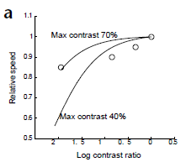
Motion And Constrast
Individuals tend to underestimate velocity in low contrast situations
perceived speed of lower-contrast grating relative to higher-contrast grating
Notes:
as a function of contrast ratio (x axis) and contrast of higher-contrast grating

Slide 45
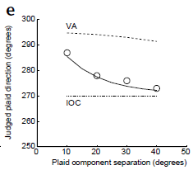
Influence Of Edge Angles On Perceived Direction Of Motion
Type II plaids
True velocity is not between the two surface normals
Vary angle between plaid components
Analogous to varying shape of rhombus
Notes:
Instead of rhombus, use plaid: same information as rhombus – two distinct orientations

Slide 46
Interaction of Edge Angle With Contrast
More uncertainty with low contrast
More alignment with acute angle
-> Union vs. intersection of edge information at low contrast with acute angle
Actual motion
VA
IOC
VA
IOC
Vertical velocity (deg/s)
Vertical velocity (deg/s)
Horizontal velocity (deg/s)
Horizontal velocity (deg/s)

Slide 47
Plaid Motion: Type I and II
Type I: true velocity lies between two normals
Type II: true velocity lies outside two normals

Slide 48
Plaids and Relative Contrast
Lower contrast
Notes:
Vary relative contrast of the two edges. Bayesian account takes in the relative quality of information from the two edges, IOC, VA do not

Slide 49
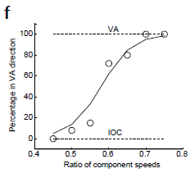
Plaids and Speed
Perceived direction of type II plaids depends on relative speed of components
Notes:
Subjects indicate if motion of plaid is left of veridical (consistent with VA) or right (consistent with IOC).

Slide 50
Plaids and Time
Viewing time reduces uncertainty

Slide 51
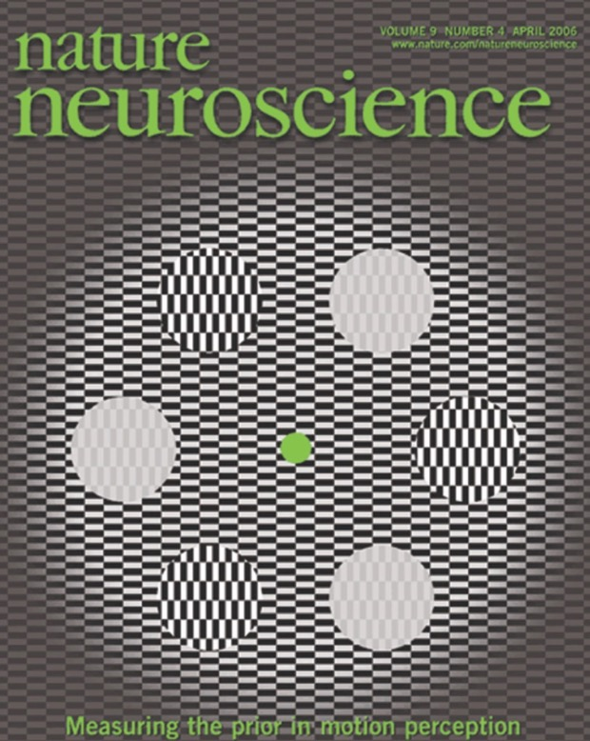
Courtesy of Aditya

Slide 52
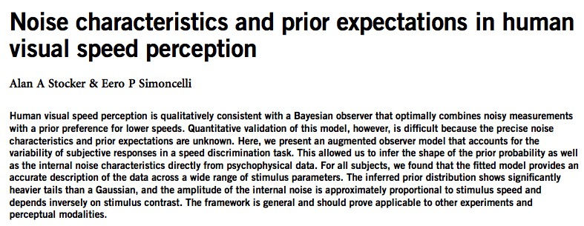
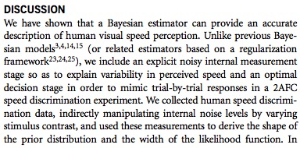

Slide 53
